Slide 1
Cloud Computing
Module 3
CLOUD ARCHITECTURE AND RESOURCE MANAGEMENT

Slide 2
3.1ARCHITECTURAL DESIGN OF COMPUTE AND STORAGE CLOUDS
3.1.1 A Generic Cloud Architecture Design
3.1.2 Layered Cloud Architectural Development
3.1.3 Virtualization Support and Disaster Recovery
3.1.4 Architectural Design Challenges

Slide 3
3.1 ARCHITECTURAL DESIGN OF COMPUTE AND STORAGE CLOUDS
3.1.1 A Generic Cloud Architecture Design:
An Internet cloud is envisioned as a public cluster of servers provisioned on demand to perform collective web services or distributed applications using data center resources.
Cloud Platform Design Goals:
Scalability, virtualization, efficiency, and reliability are four major cloud computing platform design goals.
Cloud management receives the user request, finds the correct resources, and then calls the provisioning services which invoke the resources in the cloud.
The cloud management software supports both physical and virtual machines.
Security in shared resources and shared access to data centers also pose another design challenge.
The platform needs to establish a very large-scale HPC infrastructure.
The hardware and software systems are combined to make operating easy and efficient.
System scalability can benefit from cluster architecture.
If one service takes a lot of processing power, storage capacity, or network traffic, adding more servers and bandwidth is simple.
System reliability can benefit from this architecture. Data can be put into multiple locations.
For example, user e-mail can be put in three disks which expand to different geographically separate data centers. In such a situation, even if one of the data centers crashes, the user data is still accessible. The scale of the cloud architecture can be easily expanded by adding more servers and enlarging the network connectivity accordingly

Slide 4
Enabling Technologies for Clouds
Fast platform deployment: Fast, efficient, and flexible deployment of cloud resources to provide dynamic computing environment to users
Virtual clusters on demand: Virtualized cluster of VMs provisioned to satisfy user demand and virtual cluster reconfigured as workload changes
Multitenant techniques: SaaS for distributing software to a large number of users for their simultaneous use and resource sharing if so desired
Massive data processing: Internet search and web services which often require massive data processing, especially to support personalized services
Web-scale communication :Support for e-commerce, distance education, telemedicine, social networking, digital government, and digital entertainment applications
Distributed storage :Large-scale storage of personal records and public archive information which demands distributed storage over the clouds
Licensing and billing services: License management and billing services which greatly benefit all types of cloud services in utility computing

Slide 5
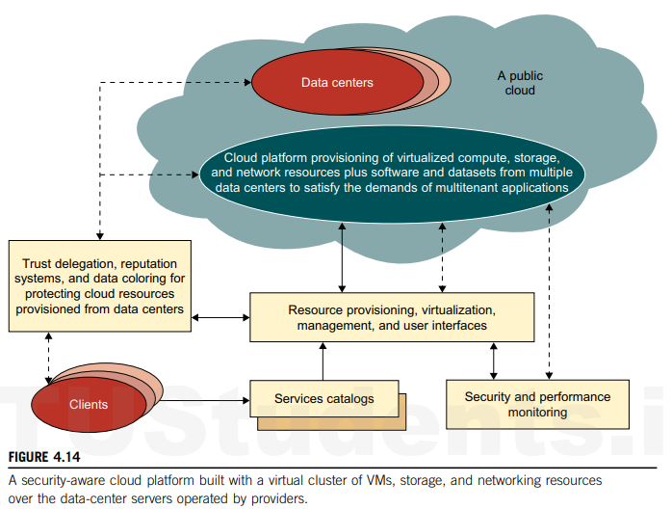
A Generic Cloud Architecture

Slide 6
The Internet cloud is envisioned as a massive cluster of servers.
These servers are provisioned on demand to perform collective web services or distributed applications using data center resources.
The cloud platform is formed dynamically by provisioning or deprovisioning servers, software, and database resources.
Servers in the cloud can be physical machines or VMs.
User interfaces are applied to request services.
The provisioning tool carves out the cloud system to deliver the requested service.
In addition to building the server cluster, the cloud platform demands distributed storage and accompanying services.
The cloud computing resources are built into the data centers, which are typically owned and operated by a third-party provider.
Consumers do not need to know the underlying technologies.

Slide 7
The software infrastructure of a cloud platform must handle all resource management and do most of the maintenance automatically.
Software must detect the status of each node server joining and leaving, and perform relevant tasks accordingly.
Cloud computing providers, such as Google and Microsoft, have built a large number of data centers all over the world.
Each data center may have thousands of servers. The location of the data center is chosen to reduce power and cooling costs. Thus, the data centers are often built around hydroelectric power.

Slide 8
3.1.2 Layered Cloud Architectural Development
The architecture of a cloud is developed at three layers: infrastructure, platform, and application.
These three development layers are implemented with virtualization and standardization of hardware and software resources provisioned in the cloud.
The infrastructure layer is deployed first to support IaaS services. This infrastructure layer serves as the foundation for building the platform layer of the cloud for supporting PaaS services. In turn, the platform layer is a foundation for implementing the application layer for SaaS applications.

Slide 9
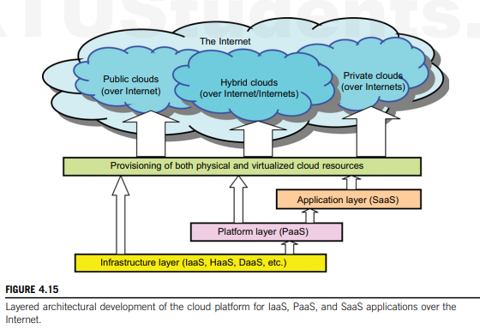

Slide 10
The infrastructure layer is built with virtualized compute, storage, and network resources. The abstraction of these hardware resources is meant to provide the flexibility demanded by users. Internally, virtualization realizes automated provisioning of resources and optimizes the infrastructure management process.
The platform layer is for general-purpose and repeated usage of the collection of software resources. This layer provides users with an environment to develop their applications, to test operation flows, and to monitor execution results and performance. The platform should be able to assure users that they have scalability, dependability, and security protection. In a way, the virtualized cloud platform serves as a “system middleware” between the infrastructure and application layers of the cloud.
The application layer is formed with a collection of all needed software modules for SaaS applications. Service applications in this layer include daily office management work, such as information retrieval, document processing, and calendar and authentication services. The application layer is also heavily used by enterprises in business marketing and sales, consumer relationship management (CRM), financial transactions, and supply chain management

Slide 11
Market-Oriented Cloud Architecture
Consumers need a specific level of QoS to meet their objectives and sustain operations.
Cloud providers must meet different QoS parameters for each consumer as negotiated in Service Level Agreements (SLAs).
Traditional system-centric resource management is insufficient. Instead, market-oriented resource management is needed to balance the supply and demand of cloud resources.
This will achieve market equilibrium between supply and demand.

Slide 12
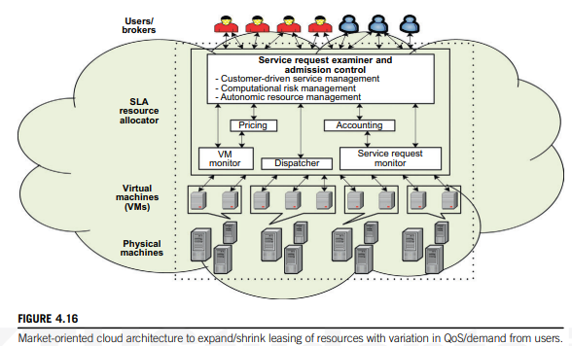

Slide 13
Users or brokers acting on user’s behalf submit service requests from anywhere in the world to the data center and cloud to be processed.
The SLA resource allocator acts as the interface between the data center/cloud service provider and external users/brokers.
It requires the interaction of the following mechanisms to support SLA-oriented resource management.
When a service request is first submitted the service request examiner interprets the submitted request for QoS requirements before determining whether to accept or reject the request.
The request examiner ensures that there is no overloading of resources whereby many service requests cannot be fulfilled successfully due to limited resources.
It also needs the latest status information regarding resource availability (from the VM Monitor mechanism) and workload processing (from the Service Request Monitor mechanism) in order to make resource allocation decisions effectively.
Then it assigns requests to VMs and determines resource entitlements for allocated VMs.

Slide 14
The Pricing mechanism decides how service requests are charged. For instance, requests can be charged based on submission time (peak/off-peak), pricing rates (fixed/changing), or availability of resources (supply/demand).
The Accounting mechanism maintains the actual usage of resources by requests so that the final cost can be computed and charged to users.
The VM Monitor mechanism keeps track of the availability of VMs and their resource entitlements.
The Dispatcher mechanism starts the execution of accepted service requests on allocated VMs.
The Service Request Monitor mechanism keeps track of the execution progress of service requests.
Multiple VMs can be started and stopped on demand on a single physical machine to meet accepted service requests, hence providing maximum flexibility to configure various partitions of resources on the same physical machine to different specific requirements of service requests.

Slide 15
3.1.3 Virtualization Support and Disaster Recovery
Key Feature of Cloud Computing Infrastructure is system virtualization which involves virtualizing servers on a shared cluster to consolidate web services.
Provisioning tools locate the physical machines and deploy virtual machines (VMs) to those nodes before scheduling services on the virtual nodes.
Users and developers do not need to know or manage the physical resources involved in service provision.
Developers can concentrate on the service logic without worrying about infrastructure issues like scalability and fault tolerance, as the virtualization layer handles these.
Users have full access to their own VMs, which are completely separate from other users’ VMs. Multiple VMs can be mounted on the same physical server.
Different VMs may run with different OSes. We also need to establish the virtual disk storage and virtual networks needed by the VMs.

Slide 16
VM Cloning for Disaster Recovery
VM technology requires an advanced disaster recovery scheme
One scheme is to recover one physical machine by another physical machine. The second scheme is to recover one VM by another VM.
Traditional disaster recovery from one physical machine to another is rather slow, complex, and expensive.
Total recovery time is attributed to the hardware configuration, installing and configuring the OS, installing the backup agents, and the long time to restart the physical machine.
The cloning of VMs offers an effective solution. The idea is to make a clone VM on a remote server for every running VM on a local server.
Among all the clone VMs, only one needs to be active. The remote VM should be in a suspended mode.
A cloud control center should be able to activate this clone VM in case of failure of the original VM, taking a snapshot of the VM to enable live migration in a minimal amount of time. The migrated VM can run on a shared Internet connection.

Slide 17
Architectural Design Challenges
Challenge 1—Service Availability and Data Lock-in Problem
Challenge 2—Data Privacy and Security Concerns
Challenge 3—Unpredictable Performance and Bottlenecks
Challenge 4—Distributed Storage and Widespread Software Bugs
Challenge 5—Cloud Scalability, Interoperability, and Standardization
Challenge 6—Software Licensing and Reputation Sharing

Slide 18
Service Availability and Data Lock-in Problem
Relying on a single company for cloud services can lead to vulnerabilities.
Using multiple cloud providers can enhance protection against failures, even if a company has multiple data centers.
Criminals can disrupt SaaS providers by making their services unavailable. Utility computing services can help defend against these attacks through quick scale-ups.
Data Privacy and Security Concerns
Public cloud networks are more susceptible to attacks compared to private networks.
Technologies like encrypted storage, virtual LANs, and network middleboxes (e.g., firewalls, packet filters) can help mitigate these risks.
Traditional Attacks include buffer overflows, DoS attacks, spyware, malware, rootkits, Trojan horses, and worms.

Slide 19
Unpredictable Performance and Bottlenecks
While multiple VMs can share CPUs and memory, I/O sharing is problematic.
Improving I/O architectures and operating systems to efficiently virtualize interrupts and I/O channels is a solution.
As applications become more data-intensive and are distributed across cloud boundaries, data placement and transport become more complex.
Cloud users and providers need to consider data placement and traffic to minimize costs, as seen in Amazon’s CloudFront service development.
To address these issues, data transfer bottlenecks must be removed, bottleneck links widened, and weak servers eliminated.
Distributed Storage and Widespread Software Bugs
There is a need to create storage systems that can scale up and down on demand to accommodate growing databases.
Designing efficient distributed Storage Area Networks (SANs) is crucial to meet scalability, data durability, and high availability (HA) expectations.
Ensuring data consistency in SAN-connected data centers is a major challenge.
Large-scale distributed bugs cannot be easily reproduced, so debugging must occur at the production scale, which is not convenient for data centers.
Virtual Machines (VMs) can capture valuable information for debugging that might be impossible to obtain otherwise.

Slide 20
Cloud Scalability, Interoperability, and Standardization
GAE automatically scales in response to load increases and decreases; users are charged by the cycles used.
AWS charges by the hour for the number of VM instances used, even if the machine is idle.
The opportunity here is to scale quickly up and down in response to load variation, in order to save money, but without violating SLAs.
Open Virtualization Format (OVF) describes an open, secure, portable, efficient, and extensible format for the packaging and distribution of VMs.
It also defines a format for distributing software to be deployed in VMs
Software Licensing and Reputation Sharing
Many cloud computing providers originally relied on open source software because the licensing model for commercial software is not ideal for utility computing.
The primary opportunity is either for open source to remain popular or simply for commercial software companies to change their licensing structure to better fit cloud computing.
One can consider using both pay-for-use and bulk-use licensing schemes to widen the business coverage.
One customer’s bad behavior can affect the reputation of the entire cloud. For instance, blacklisting of EC2 IP addresses by spam-prevention services may limit smooth VM installation.
Another legal issue concerns the transfer of legal liability. Cloud providers want legal liability to remain with the customer, and vice versa. This problem must be solved at the SLA level.

Slide 21
3.2 PUBLIC CLOUD PLATFORMS: GAE, AWS, AND AZURE
3.2.1 Google App Engine (GAE):
Google has the world’s largest search engine facilities.
The company has extensive experience in massive data processing that has led to new insights into data-center design and novel programming models that scale to incredible sizes.
The Google platform is based on its search engine expertise.
Google has hundreds of data centers and has installed more than 460,000 servers worldwide.
For example, 200 Google data centers are used at one time for a number of cloud applications. Data items are stored in text, images, and video and are replicated to tolerate faults or failures.
Google’s App Engine (GAE) offers a PaaS platform supporting various cloud and web applications.

Slide 22
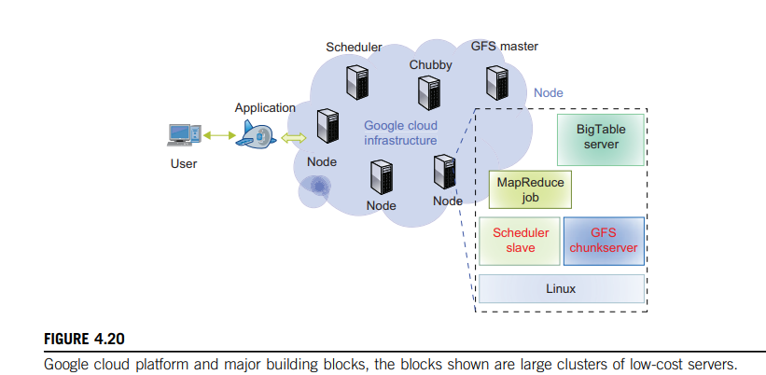
GAE Architecture

Slide 23
GFS (Google File System):
Purpose: Designed for storing large amounts of data.
Functionality: It is a scalable distributed file system developed by Google to handle large-scale data processing workloads.
MapReduce:
Purpose: Used in application program development.
Functionality: It’s a programming model and processing technique for distributed computing. It simplifies data processing across large clusters of computers by breaking down tasks into smaller sub-tasks (Map) and then combining the results (Reduce).
Chubby:
Purpose: Provides distributed application lock services.
Functionality: It is a distributed lock service that helps in managing synchronization and coordination among distributed applications, ensuring that only one instance of a service can perform a critical operation at a time.
BigTable:
Purpose: Offers a storage service for accessing structured data.
Functionality: It’s a distributed storage system designed to handle large-scale structured data. It supports dynamic control over data layout and format, making it suitable for various applications like web indexing, Google Earth, and Google Finance.
These technologies are part of Google’s infrastructure and are designed to handle the massive scale and complexity of data and services they manage.

Slide 24
Functional Modules of GAE
The GAE platform comprises the following five major components.
The datastore offers object-oriented, distributed, structured data storage services based on BigTable techniques. The datastore secures data management operations.
b. The application runtime environment offers a platform for scalable web programming and execution. It supports two development languages: Python and Java.
c. The software development kit (SDK) is used for local application development. The SDK allows users to execute test runs of local applications and upload application code.
d. The administration console is used for easy management of user application development cycles, instead of for physical resource management.
e. The GAE web service infrastructure provides special interfaces to guarantee flexible use and management of storage and network resources by GAE

Slide 25
GAE Applications
Well-known GAE applications include the Google Search Engine, Google Docs, Google Earth, and Gmail.
These applications can support large numbers of users simultaneously.
Users can interact with Google applications via the web interface provided by each application.

Slide 26
3.2.2 Amazon Web Services (AWS)
Amazon has been a leader in providing public cloud services (http://aws.amazon.com/).
Amazon applies the IaaS model in providing its services.
EC2 (Elastic Compute Cloud):
Purpose: Provides virtualized platforms for hosting VMs.
Functionality: EC2 allows users to run applications on virtual servers, offering scalable computing capacity.
S3 (Simple Storage Service):
Purpose: Offers object-oriented storage.
Functionality: S3 is used for storing and retrieving any amount of data at any time, providing a highly scalable and durable storage solution.
EBS (Elastic Block Store):
Purpose: Provides block storage.
Functionality: EBS offers persistent block storage volumes for use with EC2 instances, allowing for data to be stored and accessed like a traditional hard drive.
SQS (Simple Queue Service):
Purpose: Ensures a reliable message service between two processes.
Functionality: SQS allows messages to be sent, stored, and received between software components, even if the receiving process is not currently running. This ensures that messages are not lost and can be processed later when the receiver is available.

Slide 27
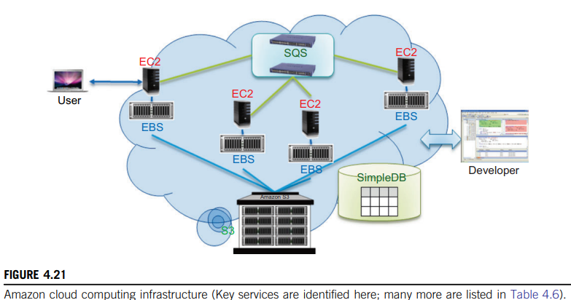
Amazon architecture

Slide 28
3.2.3 Microsoft Windows Azure
In 2008, Microsoft launched a Windows Azure platform to meet the challenges in cloud computing. This platform is built over Microsoft data centers.
The platform is divided into three major component platforms. Windows Azure offers a cloud platform built on Windows OS and based on Microsoft virtualization technology.
Applications are installed on VMs deployed on the data-center servers.
Azure manages all servers, storage, and network resources of the data center.
On top of the infrastructure are the various services for building different cloud applications.

Slide 29
Cloud-level services provided by the Azure platform are:
Live service :Users can visit Microsoft Live applications and apply the data involved across multiple machines concurrently.
.NET service :This package supports application development on local hosts and execution on cloud machines.
SQL Azure: This function makes it easier for users to visit and use the relational database associated with the SQL server in the cloud.
SharePoint service: This provides a scalable and manageable platform for users to develop their special business applications in upgraded web services.
Dynamic CRM(customer relationship management) service: This provides software developers a business platform in managing CRM applications in financing, marketing, and sales and promotions.

Slide 30
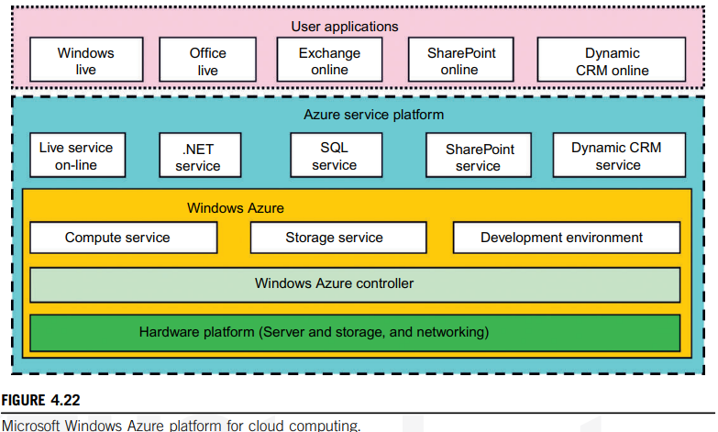

Slide 31
3.3 EMERGING CLOUD SOFTWARE ENVIRONMENTS
Popular cloud operating systems and emerging software environments are open source :
Eucalyptus
Nimbus
Open Stack

Slide 32
3.3.1 Open Source Eucalyptus and Nimbus
Eucalyptus is a product from Eucalyptus Systems (www.eucalyptus.com) that was developed out of a research project at the University of California, Santa Barbara.
Eucalyptus was initially aimed at bringing the cloud computing paradigm to academic supercomputers and clusters.
Key Features
Eucalyptus takes many design queues from Amazon’s EC2, and its image management system is no different.
Eucalyptus stores images in Walrus, the block storage system that is analogous to the Amazon S3 service.
Eucalyptus includes a user interface for managing users and images, making it easier to handle cloud resources.

Slide 33
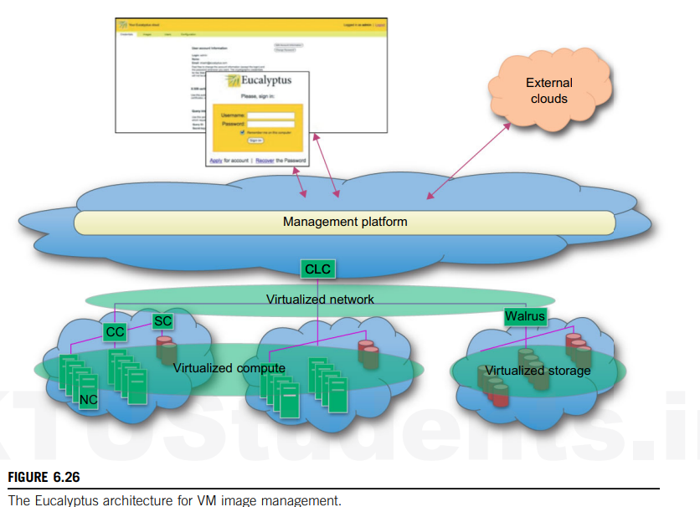

Slide 34
Eucalyptus Architecture
Open Software Environment: Eucalyptus is an open software environment, meaning it can be freely used and modified.
Virtual Clustering: The architecture supports virtual clustering, which helps in managing and deploying virtual machines (VMs).
VM Image Management: Eucalyptus’s image management system is similar to Amazon’s EC2. It uses Walrus for storing images, allowing users to bundle, upload, and register their own root file systems. These images can be retrieved from any availability zone, facilitating the creation and deployment of specialized virtual appliances.

Slide 35
Nimbus is a set of open-source tools designed to provide an Infrastructure as a Service (IaaS) cloud computing solution.
Nimbus Web Interface
Nimbus Web: This is a web interface designed to provide both administrative and user functions in a user-friendly manner. It is built around a Python Django web application, which can be deployed separately from the Nimbus service.
Cumulus Storage Cloud
Cumulus: This storage cloud implementation is integrated with Nimbus’s central services but can also function independently.
Client Compatibility: Tools like boto and s2cmd, which work with the S3 REST API, are compatible with Cumulus.
Nimbus supports two main resource management strategies:
Resource Pool Mode: In this default mode, Nimbus controls a pool of VM manager nodes and can start VMs as needed.
Pilot Mode: In this mode, Nimbus requests a VM manager from a cluster’s Local Resource Management System (LRMS) to deploy VMs.

Slide 36
3.3.2 OpenStack
OpenStack was introduced by Rackspace and NASA in July 2010. The project is building an open source community spanning technologists, developers, researchers, and industry to share resources and technologies with the goal of creating a massively scalable and secure cloud infrastructure.
OpenStack focuses on the development of two aspects of cloud computing to address compute and storage aspects with the OpenStack Compute and OpenStack Storage solutions.
“OpenStack Compute is the internal fabric of the cloud creating and managing large groups of virtual private servers”
“OpenStack Object Storage is software for creating redundant, scalable object storage using clusters of commodity servers to store terabytes or even petabytes of data.”

Slide 37
OpenStack Compute
As part of its computing support efforts, OpenStack is developing a cloud computing fabric controller, a component of an IaaS system, known as Nova.
The architecture for Nova is built on the concepts of shared-nothing and messaging-based information exchange. Hence, most communication in Nova is facilitated by message queues.
To achieve the shared-nothing paradigm, the overall system state is kept in a distributed data system.
State updates are made consistent through atomic transactions.
Nova is implemented in Python while utilizing a number of externally supported libraries and components. This includes boto, an Amazon API provided in Python, and Tornado, a fast HTTP server used to implement the S3 capabilities in OpenStack

Slide 38
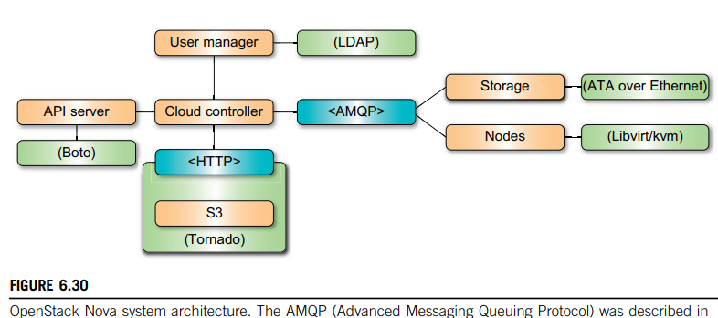
In this architecture, the API Server receives HTTP requests from boto, converts the commands to and from the API format, and forwards the requests to the cloud controller.
The cloud controller maintains the global state of the system, ensures authorization while interacting with the User Manager via Lightweight Directory Access Protocol (LDAP), interacts with the S3 service, and manages nodes, as well as storage workers through a queue.
Additionally, Nova integrates networking components to manage private networks, public IP addressing, virtual private network (VPN) connectivity, and firewall rules

Slide 39
Open Stack Storage
The OpenStack storage solution is built around a number of interacting components and concepts, including a proxy server, a ring, an object server, a container server, an account server, replication, updaters, and auditors.
The role of the proxy server is to enable lookups to the accounts, containers, or objects in OpenStack storage rings and route the requests.
A ring includes the concept of using zones, devices, partitions, and replicas. Hence, it allows the system to deal with failures, and isolation of zones representing a drive, a server, a cabinet, a switch, or even a data center.
The Object Server is a very simple blob storage server that can store, retrieve and delete objects stored on local devices.” Objects are stored as binary files with metadata stored in the file’s extended attributes.
To list objects, a container server can be utilized. Listing of containers is handled by the account server

Slide 40
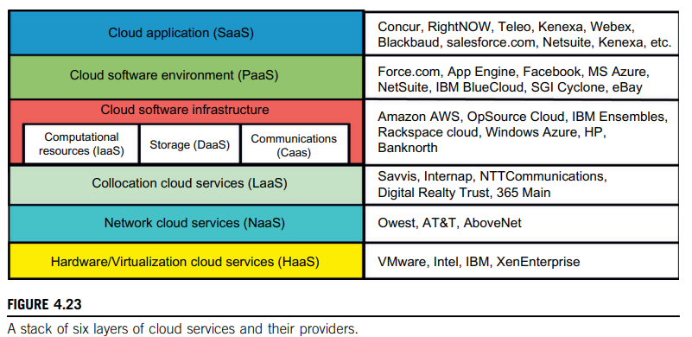
3.4 Extended Cloud Computing Services
The six layers of cloud services are divided into two main categories: the top three layers (SaaS, PaaS, and IaaS) and the bottom three layers (HaaS, NaaS, and LaaS).

Slide 41
Top Three Layers
Software as a Service (SaaS): The topmost layer, providing software applications.
Platform as a Service (PaaS): Sits on top of IaaS, offering a cloud platform for developing and deploying applications.
Infrastructure as a Service (IaaS): Provides compute and storage infrastructure.
Bottom Three Layers
Hardware as a Service (HaaS): The foundational layer, offering physical hardware.
Network as a Service (NaaS): Interconnects hardware components, including virtual LANs.
Location as a Service (LaaS): Provides collocation services to house, power, and secure hardware and network resources.
Additional Services
Data as a Service (DaaS) and Communication as a Service (CaaS) are also part of the cloud infrastructure layer.

Slide 42
Software Stack for Cloud Computing
Developers must consider designing the system to meet critical requirements such as high throughput, HA, and fault tolerance.
Even the operating system might be modified to meet the special requirement of cloud data processing.
Based on the observations of some typical cloud computing instances, such as Google, Microsoft, and Yahoo!, cloud computing software's overall software stack structure can be viewed as layers.
Each layer has its own purpose and provides the interface for the upper layers just as the traditional software stack does.
However, the lower layers are not completely transparent to the upper layers.
The platform for running cloud computing services can be either physical servers or virtual servers.

Slide 43
Runtime Support Services
Cluster monitoring is used to collect the runtime status of the entire cluster.
The scheduler queues the tasks submitted to the whole cluster and assigns the tasks to the processing nodes according to node availability

Slide 44
3.5 Resource Provisioning and Platform Deployment
Provisioning of Compute Resources:
Providers supply cloud services by signing SLAs with end users. The SLAs must commit sufficient resources such as CPU, memory, and bandwidth that the user can use for a preset period.
Underprovisioning of resources will lead to broken SLAs and penalties. Overprovisioning of resources will lead to resource underutilization, and consequently, a decrease in revenue for the provider.
Deploying an autonomous system to efficiently provision resources to users is a challenging problem.
The difficulty comes from the unpredictability of consumer demand, software and hardware failures, heterogeneity of services, power management, and conflicts in signed SLAs between consumers and service providers.
Efficient VM provisioning depends on the cloud architecture and management of cloud infrastructures.
Resource provisioning schemes also demand fast discovery of services and data in cloud computing infrastructures.
In a virtualized cluster of servers, this demands efficient installation of VMs, live VM migration, and fast recovery from failures.

Slide 45
Three different resource provisioning methods are:
The demand-driven method provides static resources and has been used in grid computing for many years.
The event-driven method is based on predicted workload by time.
The popularity-driven method is based on Internet traffic monitored

Slide 46
Demand-Driven Resource Provisioning
This method adds or removes computing instances based on the current utilization level of the allocated resources.
The demand-driven method automatically allocates two Xeon processors for the user application, when the user was using one Xeon processor more than 60 percent of the time for an extended period.
In general, when a resource has surpassed a threshold for a certain amount of time, the scheme increases that resource based on demand.
When a resource is below a threshold for a certain amount of time, that resource could be decreased accordingly

Slide 47
Event-Driven Resource Provisioning
This scheme adds or removes machine instances based on a specific time event.
The scheme works better for seasonal or predicted events such as Christmas time in the West and the Lunar New Year in the East.
During these events, the number of users grows before the event period and then decreases during the event period.
This scheme anticipates peak traffic before it happens.
The method results in a minimal loss of QoS, if the event is predicted correctly.
Otherwise, wasted resources are even greater due to events that do not follow a fixed pattern.

Slide 48
Popularity-Driven Resource Provisioning
In this method, the Internet searches for popularity of certain applications and creates the instances by popularity demand.
The scheme anticipates increased traffic with popularity.
Again, the scheme has a minimal loss of QoS, if the predicted popularity is correct.
Resources may be wasted if traffic does not occur as expected.

Slide 49
3.6 Virtual Machine Creation and Management
Independent Service Management- By using independent service providers, the cloud applications can run different services at the same time
Running Third-Party Applications-Cloud platforms have to provide support for building applications that are constructed by third-party application providers or programmers.
Virtual Machine Manager-The VM manager is the link between the gateway and resources. The manager manage VMs deployed on a set of physical resources

Slide 50
Virtual Machine Templates- A VM template is analogous to a computer’s configuration and contains a description for a VM with the following static information:
The number of cores or processors to be assigned to the VM
The amount of memory the VM requires
The kernel used to boot the VM’s operating system
The disk image containing the VM’s file system
The price per hour of using a VM
Distributed VM manager- A distributed VM manager makes requests for VMs and queries their status. This manager requests VMs from the gateway on behalf of the user application. The manager obtains the list of requested VMs from the gateway

Slide 51
The technologies and components of data centres
A data center consists of several key technologies and components, including: servers (computing power), storage systems (data storage), networking equipment (data communication), power supply (UPS and backup generators), cooling systems (temperature control), and security measures (physical and cyber protection), all working together to manage and distribute data across multiple devices and locations.

Slide 52
Servers: The core component of a data center, responsible for processing and managing data, including various types like rack servers and blade servers.
Storage Systems: Devices that store data, including hard drives, solid-state drives (SSDs), and storage area networks (SANs).
Networking Equipment:
Devices like routers, switches, and firewalls that facilitate data communication between servers and external networks.
Power Supply: Uninterruptible Power Supply (UPS): Provides continuous power to equipment during power outages.
Backup Generators: Generate power in case of prolonged power failures.
Cooling Systems:
Air Conditioning: Maintains optimal temperature and humidity levels to prevent equipment from overheating.
Liquid Cooling: Advanced cooling systems using liquid to cool high-density computing areas.
Security Measures:
Physical Security: Access controls, surveillance cameras, and perimeter security to protect physical infrastructure.
Cybersecurity: Firewalls, intrusion detection systems, and data encryption to protect against cyber threats.
Virtualization Technology: Enables multiple virtual machines to run on a single physical server, enhancing efficiency and resource utilization.
Data Center Tier Classification: A system to categorize data centers based on their reliability, uptime, and redundancy levels.
Edge Data Centers: Smaller data centers located closer to end-users to provide low-latency access to data for applications like IoT and streaming.

